Slide 1
GMO Toxicity
Erick Dobrzynski, Valerie Lyon

Slide 2
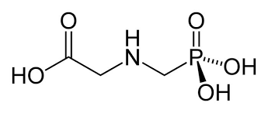
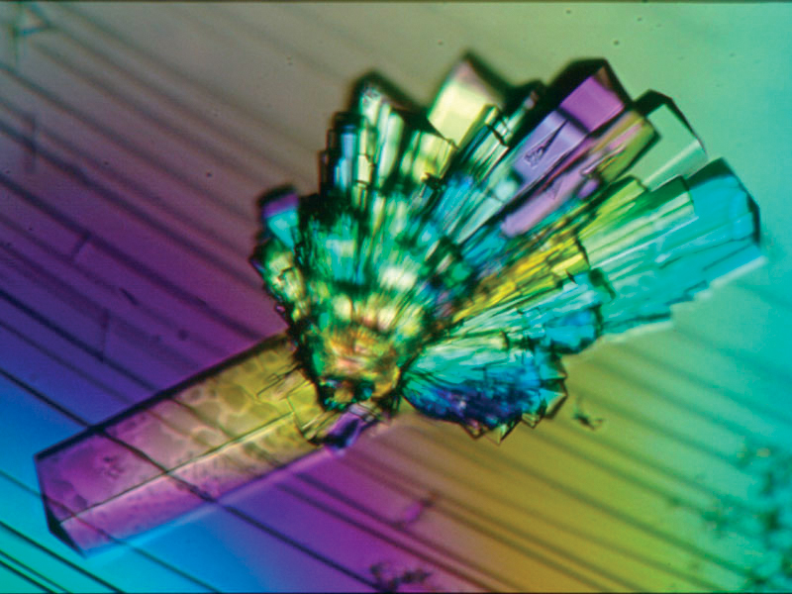
What is a GMO?
2 Types
Plants engineered to withstand herbicide (Glyphosate)
Those engineered to produce their own insecticide (Crystal Protein)

Slide 3
GMO Pros Cons
Better looking produce
Decreased disease in the produce creating better product
Possibility to use these to aid in reviving the soil.
Edible vaccines/ medication?
Improved nutritional properties
Increased yield
Bad continued
Economical hardship on the farmer
FDA passed a law stating that GMO's do not have to be labeled while organic foods do.
They are harmful and support autoimmune expression. (cancer, allergies etc.)
GMO corn affects hepatorenal toxicity levels in rats, especially in the females.
Outside organism genetic modification
Antibiotic resistance
Environmental changes
Notes:
environment: more insecticides and herbicides may affect water supply and other organisms
may ruin normal local ecology

Slide 4
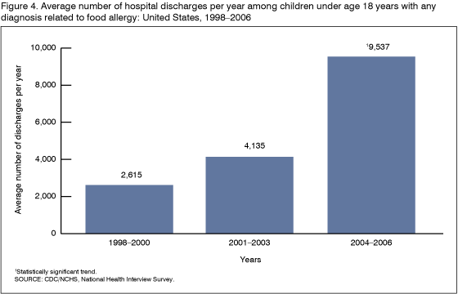

Slide 5
Toxicokinetics! WOO
The only toxicokinetic parameter that could be determined is elimination of glyphosate.
Glyphosate peak absorbance at 4-6 hours.
Half life between 3-4 hours after absorption.
Link: https://www.youtube.com/watch?v=oB6fUqmyKC8
Notes:
No human studies have been done with GMO.

Slide 6
GMO Symptoms
Asymptomatic: 27.6% of patients in the study didn’t show any symptoms
Mild Symptoms: 64%% of patients experience nausea, vomiting, diarrhea, abdominal pain.
Bradycardia, hypotension, Tachycardia, and Tachypnea
Severe Symptoms: Similar as Mild but some required intubation and ventilators.
Some experienced seizures and depressed level of consciousness.
Death: 3.2%, due to progressive hypotension.
GMO the silent killer
Fore more info check out this Podcast, from a former Gov’t scientist.

Slide 7
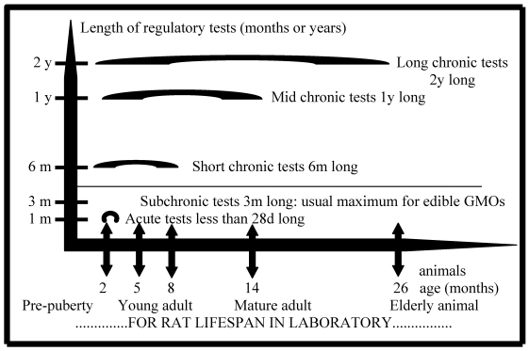
GMO Response (Rats)
Notes:
awaiting approval for use
More long term testing is required to help determine the safety of GM products.

Slide 8
Things to Consider
GMO products are subsidized by the government
Organic farmers are checked constantly for product control and for their processes
Soil
Fertilizer
Food
Veterinary visits - no antibiotics
Organic farmers pay for the certification to be able to use this buzzword
Watch the documentary “The World According to Monsanto”
Monsanto has previous employees all over the government.
NOP started in 1990 with the passing of the Organic Food Production Act

Slide 9
Useful Links
For more info on how GMO’s are manufactured click the link below.
Link: https://www.youtube.com/watch?v=2G-yUuiqIZ0
Organic vs Conventional.
https://www.youtube.com/watch?v=mg4bllcO6Sw
Podcast
Pesticides found in our body.
Link: https://www.youtube.com/watch?v=oB6fUqmyKC8

Slide 10
Bibliography
http://www.livestrong.com/article/213053-pros-cons-of-gmo-foods/
http://articles.mercola.com/sites/articles/archive/2014/10/28/new-toxic-genetically-engineered-crops.aspx
http://www.ncbi.nlm.nih.gov/pmc/articles/PMC2875113/
http://www.ncbi.nlm.nih.gov/pmc/articles/PMC2793308/?tool=myncbi#Section5title
http://medicina.lsmuni.lt/med/0802/0802-01e.pdf
http://www.ams.usda.gov/AMSv1.0/ams.fetchTemplateData.do?template=TemplateN&navID=OrgCertificationLinkNOPOrganicLabeling&rightNav1=OrgCertificationLinkNOPOrganicLabeling&topNav=&leftNav=&page=NOPAccreditationandCertification&resultType=&acct=nopgeninfo
http://www.livestrong.com/video/1010615-disadvantages-genetic-vegetables/

